Slide 1
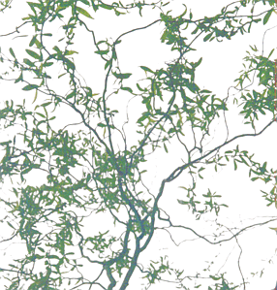
Bender & Visualization(s)
Smart&Transparent Python/LoKi-based Physics Analysis +4 demo
Vanya Belyaev
CERN & ITEP/Moscow

Slide 2

LoKi + Python = Bender
Python allows to make the code even more compact and readable
Python allows to keep the code and the options together in one file
  Improved locality
Python allows to make analysis interactive
  Invoke Bender from Panoramix prompt ?
    Still into ink-bottle, not tested yet, should be trivial
The only one executable for all persons and all their jobs
  No private libraries, no compiler, linker etc
    Login into lxplus
    BenderEnv v2r0
    enjoy
‘Platform independent’ (to some extent)
  Develop and test algorithms on laptop (Win) and then send the script to ‘large’ (external) center (Linux)
Each separate analysis – 1 self-contained Python file with code and options
  Easy to send 1 file to other center e.g. for preselection

Slide 3
Interactivity
Interactivity is not only “Python prompt” !
  One needs visualization
    Histograms, (NTuples)
    Event Display
Bender is friendly guy!
It nicely collaborates with
  ROOT via SEAL dictionaries (thanks to Pere)
    Native ROOT histograms + (NTuples) + all ROOT stuff
  ROOT via PI
    AIDA histograms
  HippoDraw via PI
      With some headache (PI is not bug-free, even demo examples )
    AIDA histograms & clouds
  LaJoconde
    AIDA 1D histograms
    Event Display, Geometry, etc
4 demos!

Slide 4
Analysis Model
My view on analysis models is highly biased
  I am physicist,
  I am making physics analyses in LHCb
  I am code developer
AS A SEQUENCE :
I DO NOT KNOW EXACTLY WHAT PHYSICISTS NEED
Preselection
  Significant reduction of data sample
  Simple/Efficient/Short/Dumb (1-2 pages) selection (C++ or Python) algorithm
  (several times, with miniDST and/or Event Tag Collections)
(Pseudo) interactive analysis (≤ few hours) with more sophisticated C++ or Python algorithms
  (several times, with miniDST and/or Event Tag Collections)
  Produce NTuples
Interactive analysis with ROOT or PAW

Slide 5
Analysis Model : Bender
Develop (interactively) Bender-base algorithms
Test it with events,
Inspect histograms, (tuples)
Inspect TES,
Visualizse ‘interesting’ events’
Update algorithm
Run “many” events
  (collaborate with Ganga?)
From one Python prompts in one interactive ‘job’

Slide 6
Analysis models
Bender is friendly guy! It nicely collaborates with
  ROOT via SEAL dictionaries (thanks to Pere)
    Native ROOT histograms + (NTuples) + allroot stuff
  ROOT via PI
    AIDA histograms
  HippoDraw via PI
    With some headache (PI is not bug-free, even demo examples )
    AIDA histograms & clouds
  LaJoconde
    AIDA 1D histograms
    Event Display, Geometry, etc
4 demos!

Slide 7
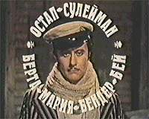
Bender
Ostap Suleiman Berta Maria Bender-bei
Остап Сулейман Берта Мария Бендер-бей
The cult-hero of two Russian books by I. Ilf & E. Petrov
  “The 12 chairs”
    12 стульев
  “The golden calf”
    Золотой телёнок
The title: “The great schemer”
Attractive & brilliant cheater
Essential for successful and good physics analysis

